Slide 1


STORY BOARD
BY TEAM: ELITES

Slide 2
TEAM MEMBERS
K.Rajesh
D.Pavan Balaji
Y.Jeneeliya
T.G.Monisha
Shaik.Haleema Saadiya

Slide 3


AGENDA
Introduction
Purpose of SAS(Super Market Automation Software)
Super Market Overview
Storyboard
Conclusion

Slide 4
INTRODUCTION
PURPOSE:
To enhance operational efficiency, improve customer experience, and maximize profitability through streamlined inventory management, sales processing, and data-driven decision-making.

Slide 5
Project Overview
The supermarket operates as a retail establishment offering a wide range of products, including groceries, household items, and perishables, providing customers with a convenient and comprehensive shopping experience. The supermarket automation software project aims to enhance operational efficiency, inventory management, and customer engagement within this retail environment.

Slide 6

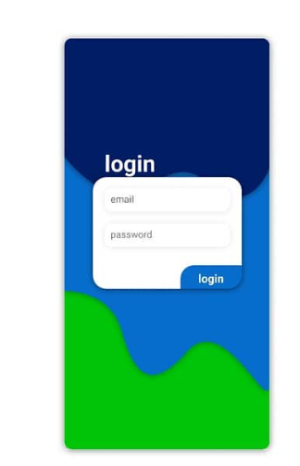


Slide 7
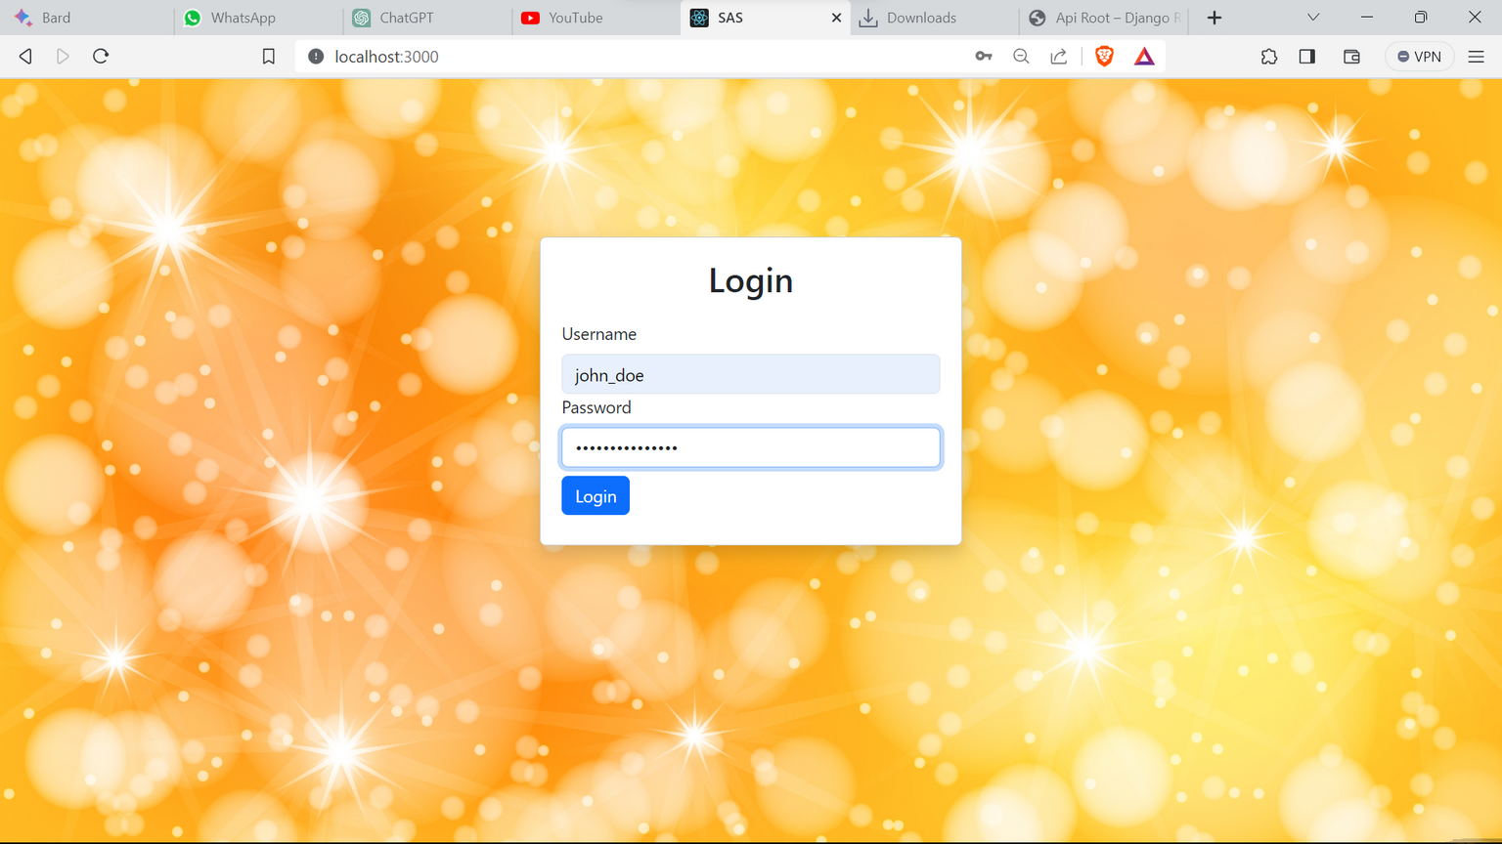

Slide 8
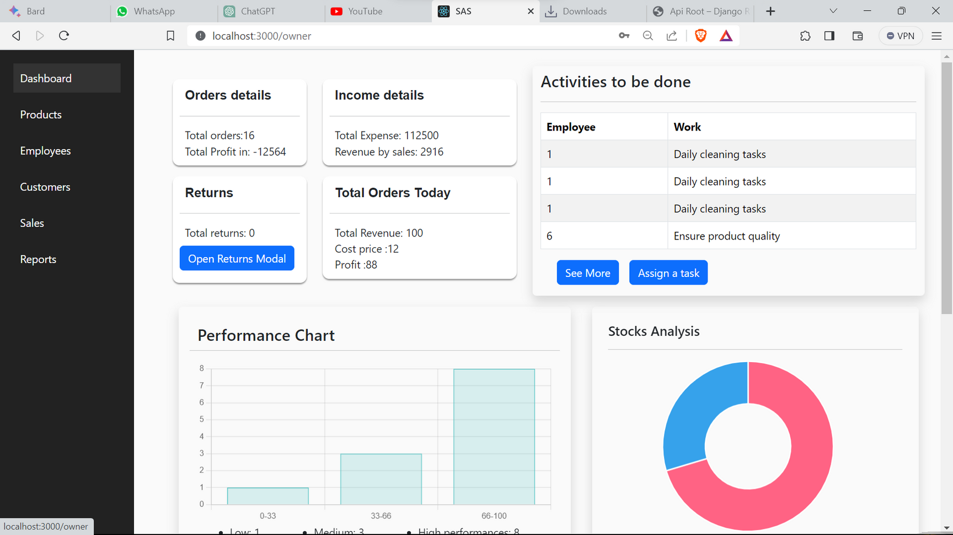

Slide 9
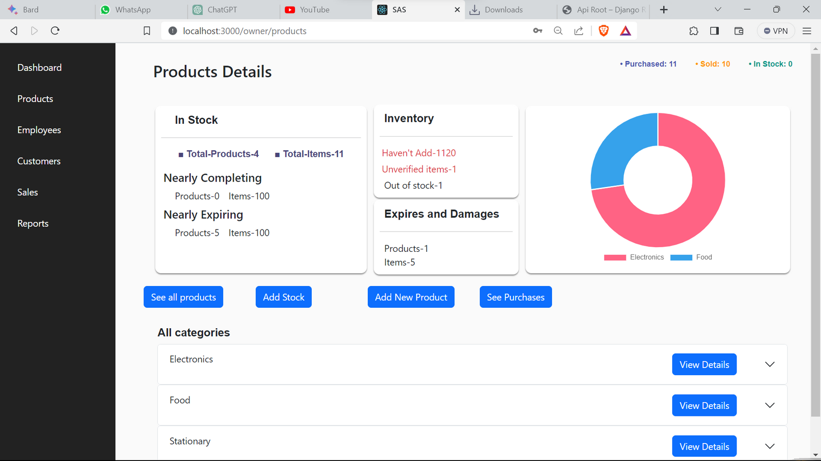

Slide 10
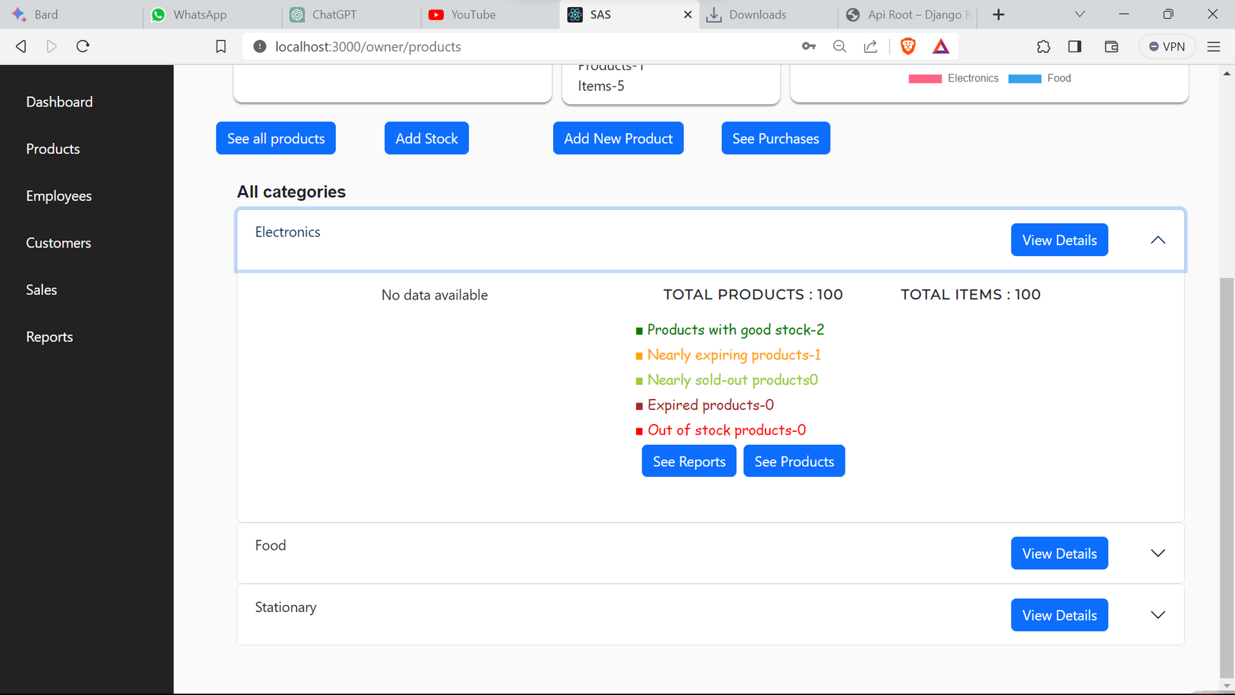

Slide 11
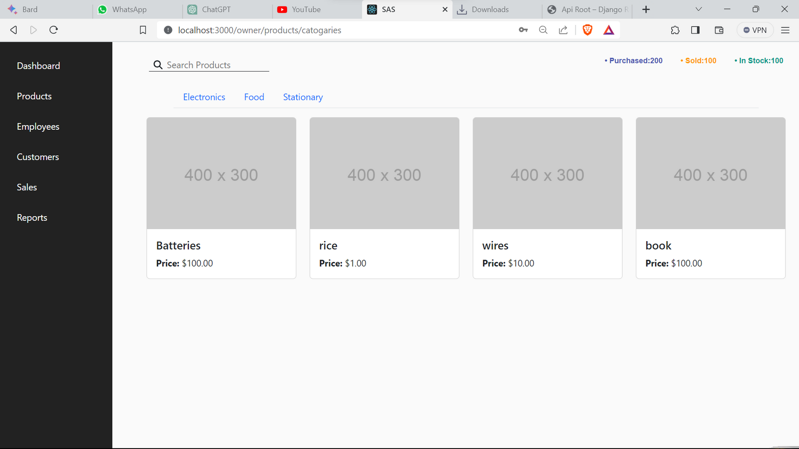

Slide 12
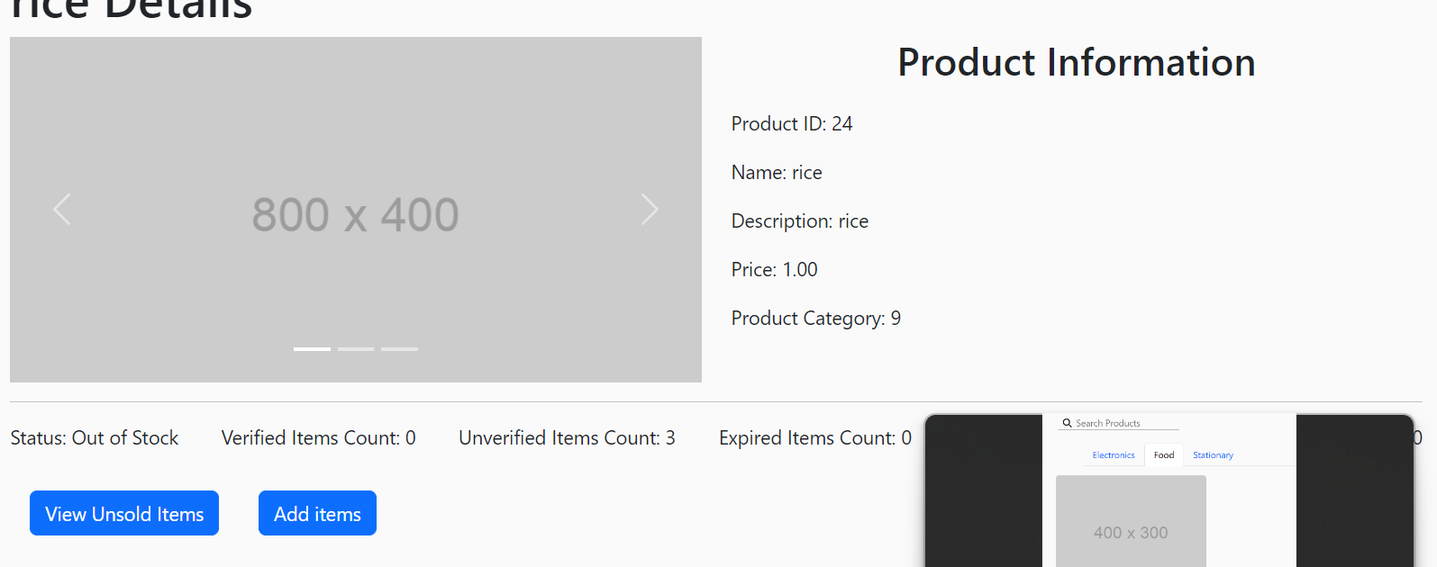

Slide 13
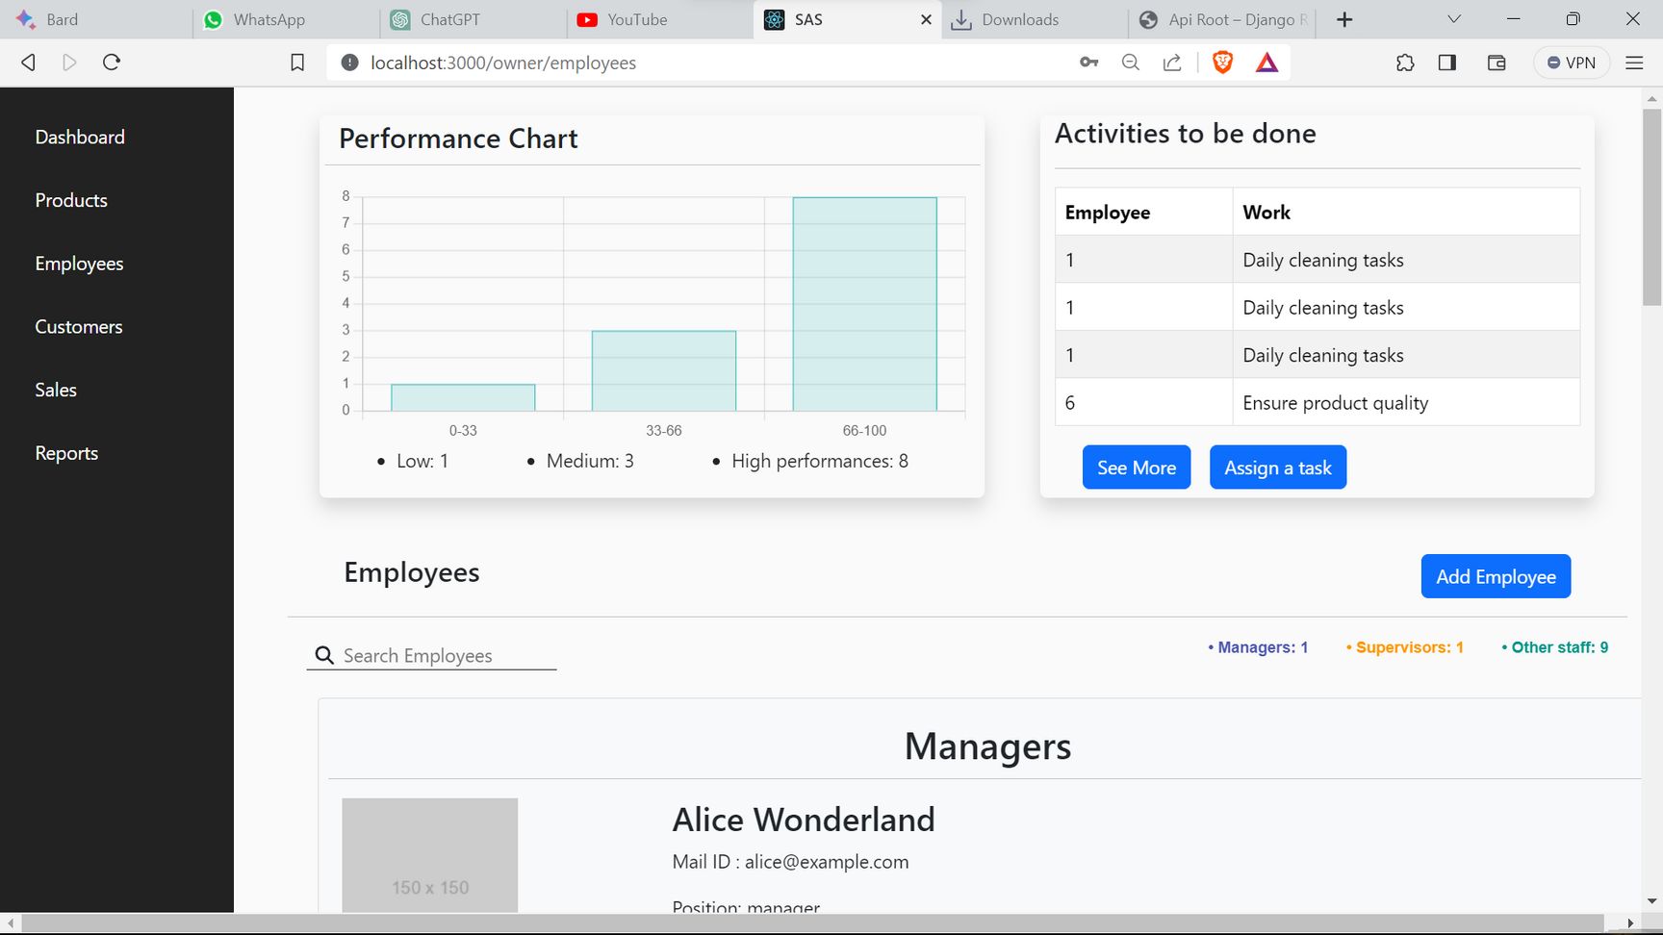

Slide 14
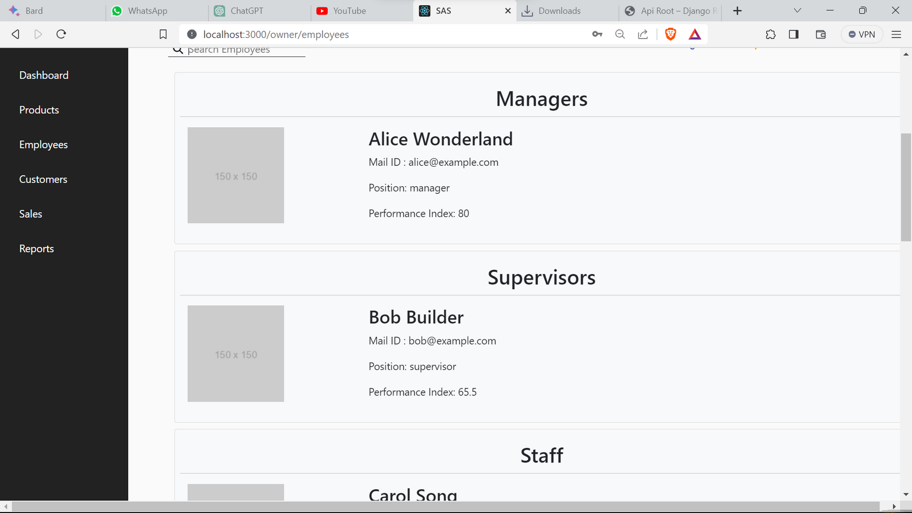

Slide 15
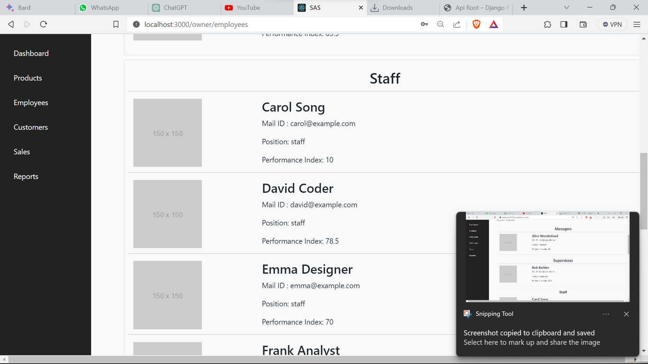

Slide 16
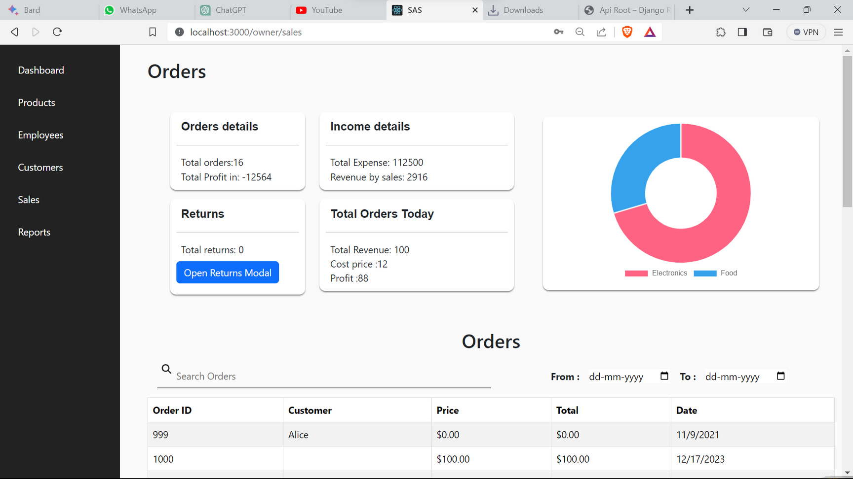

Slide 17
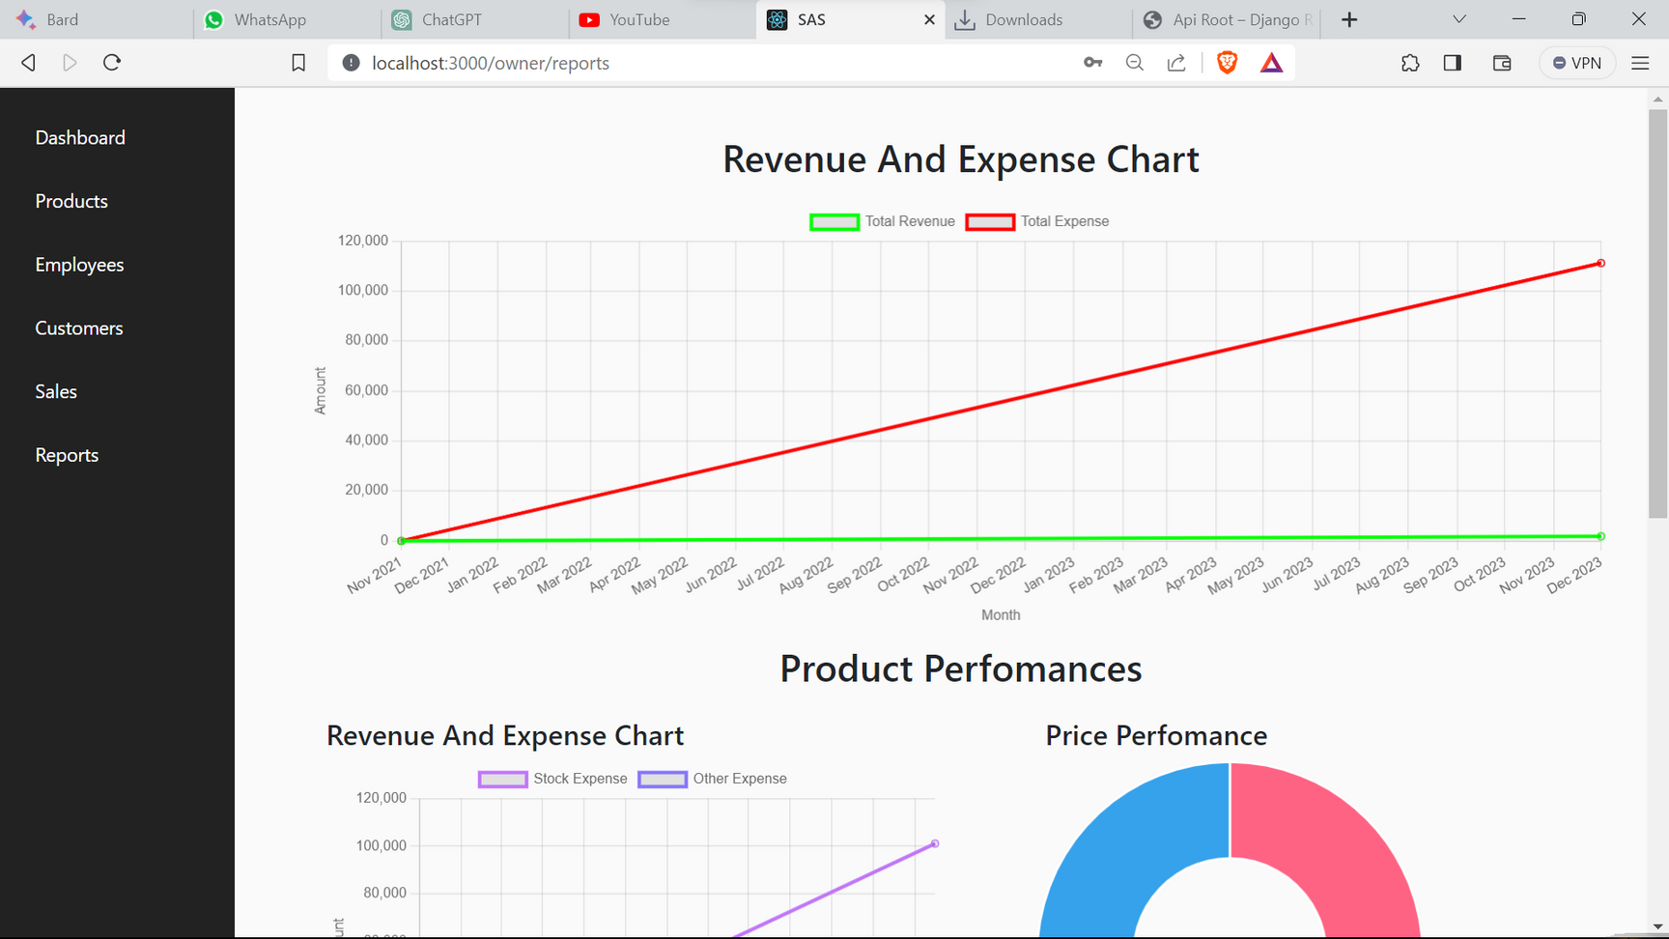

Slide 18
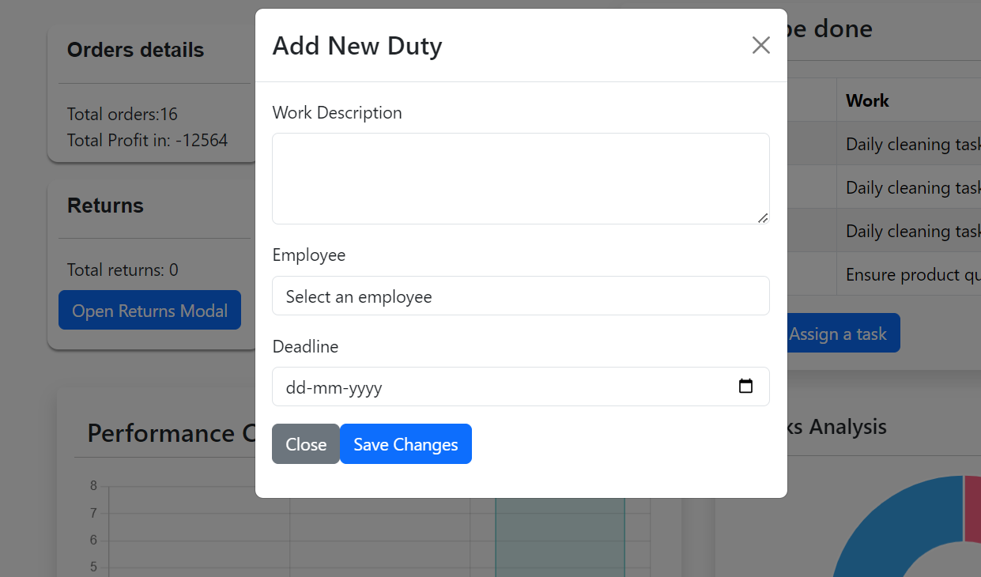

Slide 19
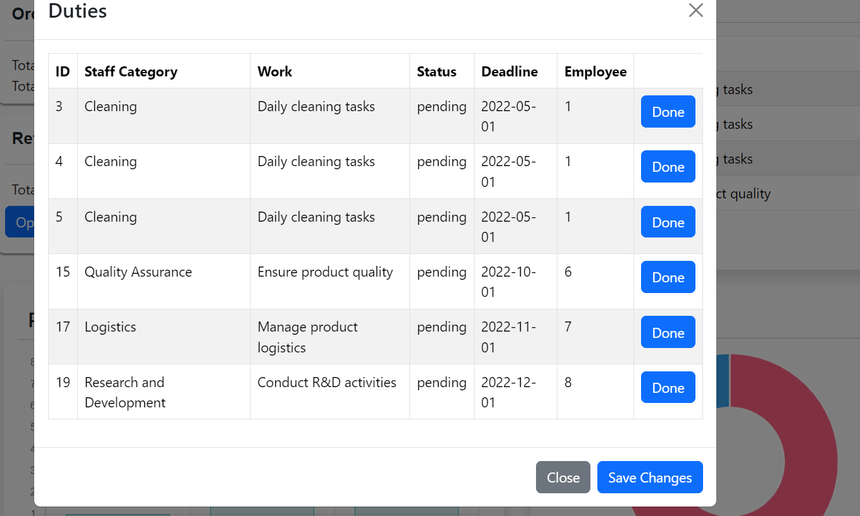

Slide 20
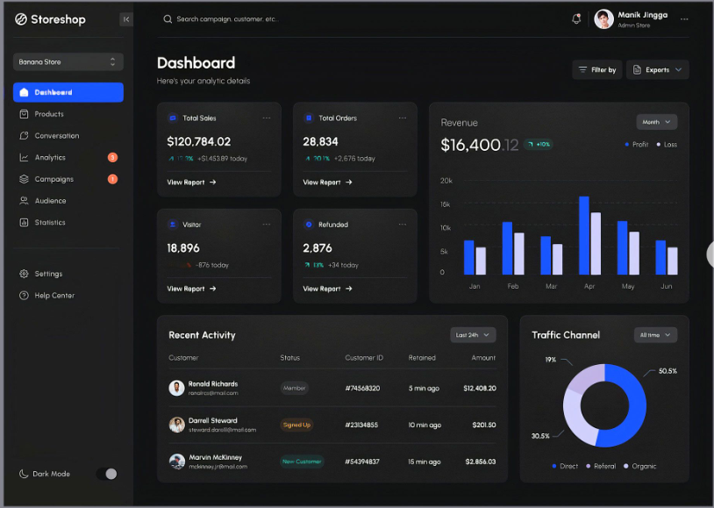

Slide 21
STORY BOARD
BACK STORY
In the heart of Green Valley, where tradition meets technology, GreenMart faces the challenges of a bustling supermarket stuck in manual processes. The dedicated team, determined to elevate the shopping experience, decides to embark on a transformative journey. Inspired by the need for efficiency, convenience, and a touch of modernity, the team conceptualizes "SmartCartEase" - a supermarket automation software designed to make every shopping trip a seamless and enjoyable experience.

Slide 22
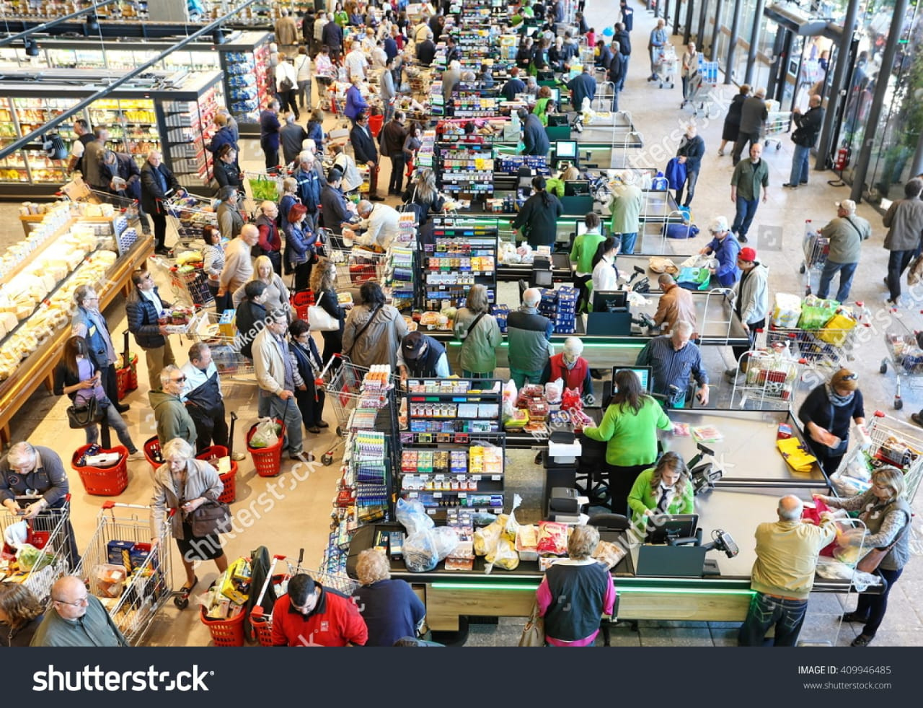
"GreenMart, a beloved supermarket, caught in the chaos of traditional checkout processes."

Slide 23
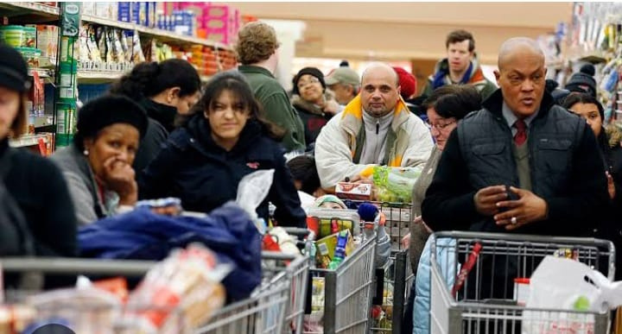
"Challenges emerge - long queues, manual inventory, and the need for a change."

Slide 24

. "A vision takes shape - a supermarket where technology meets tradition, creating a harmonious shopping environment."

Slide 25
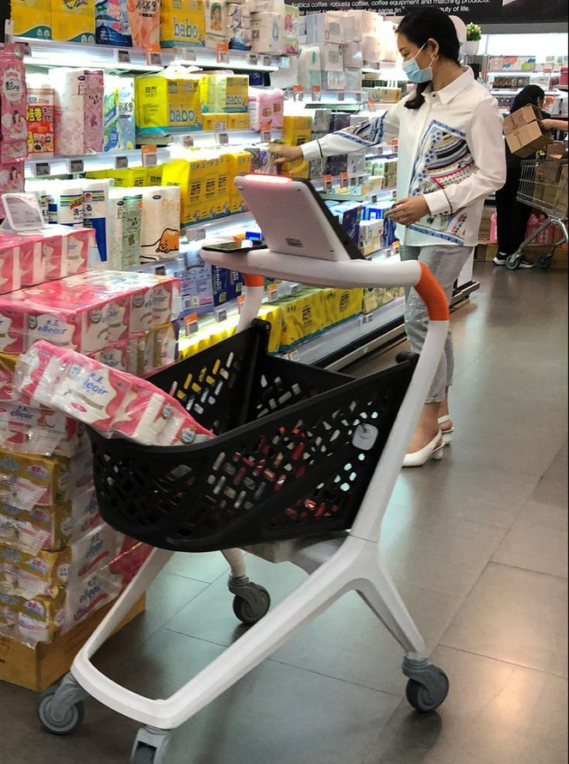
"Meet SmartCartEase - the superhero software designed to simplify and enhance the shopping journey."

Slide 26
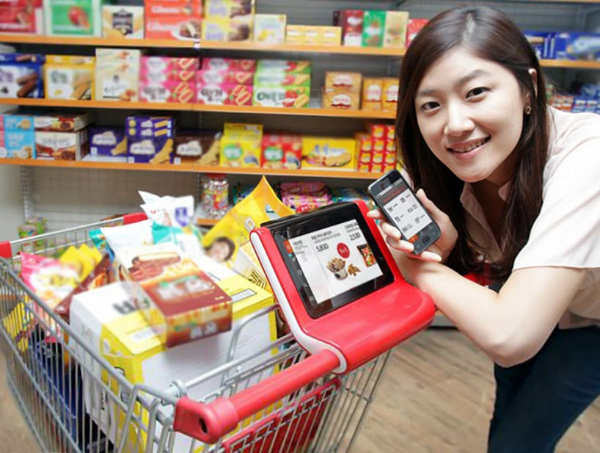
"Checkout made effortless - SmartCartEase ensures quick and easy transactions."

Slide 27
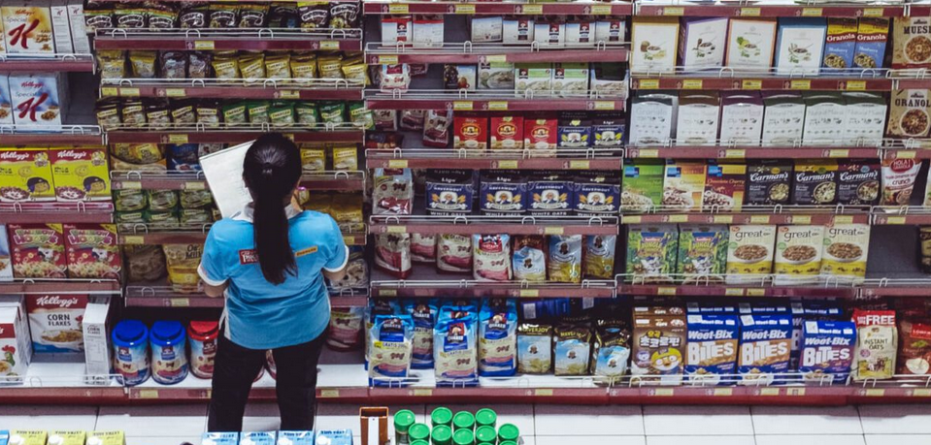
"Say goodbye to stockouts - SmartCartEase ensures intelligent and real-time inventory management."

Slide 28

"Smiles all around - SmartCartEase brings joy to both staff and shoppers."

Slide 29
Conclusion
"SmartCartEase - where technology meets tradition, transforming your GreenMart experience into something extraordinary."

Slide 30
Thank You

